Slide 1
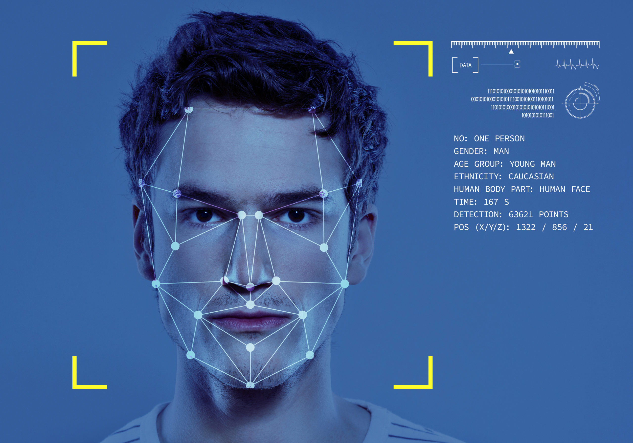
Facial Recognition and detection
By
Syed Muhammad jhon raza Naqvi
Syed Muhammad ali
Syed Muhammad Hamza raza

Slide 2
Tools used
OS: WINDOWS AND LINUX(UBUNTU)
LANGUAGE: PYTHON 3
JUPYTER NOTEBOOK, SUBLIME TEXT NOTEPAD++, VISUAL CODE.
GUI: TKINTER

Slide 3
FACIAL DETECTION AND RECOGNITION USING CV2 AND PYTHON LIBRARIES
S. M. JHON RAZA NAQVI

Slide 4
WHAT IS FACIAL RECOGNITION?
FACIAL RECOGNITION IS THE PROCESS OF IDENTIFYING A PARTICULAR OBJECT WITHIN AN INPUT PICTURE/VIDEO USING DATA PREVIOUSLY GATHERED AND PROCESSED AND MATCHING THE INPUT WITH THAT DATA TO FORM SIMILARITIES AND DIFFERENCES BETWEEN THEM AND CLASSIFYING THE INPUT(S) BASED ON THOSE SIMILARITIES.

Slide 5
LIBRARIES USED
face_recognition
os
cv2
numpy
from time import sleep
tkinter
from tkinter import *
from tkinter import filedialog
from PIL import ImageTk, Image

Slide 6
A LITTLE ABOUT THE facial_recognition LIBRARY
It is the world's simplest face recognition library.
Built using dib's state-of-the-art face recognition built with deep learning.
The model has an accuracy of 99.38% on the Labeled Faces in the Wild benchmark.
This also provides a simple face_recognition command line tool that lets
you do face recognition on a folder of images from the command line!

Slide 7
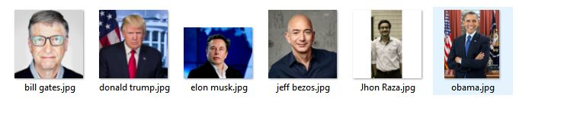
TRAINING DATA (PICTURES)

Slide 8

TESTING PICTURE

Slide 9
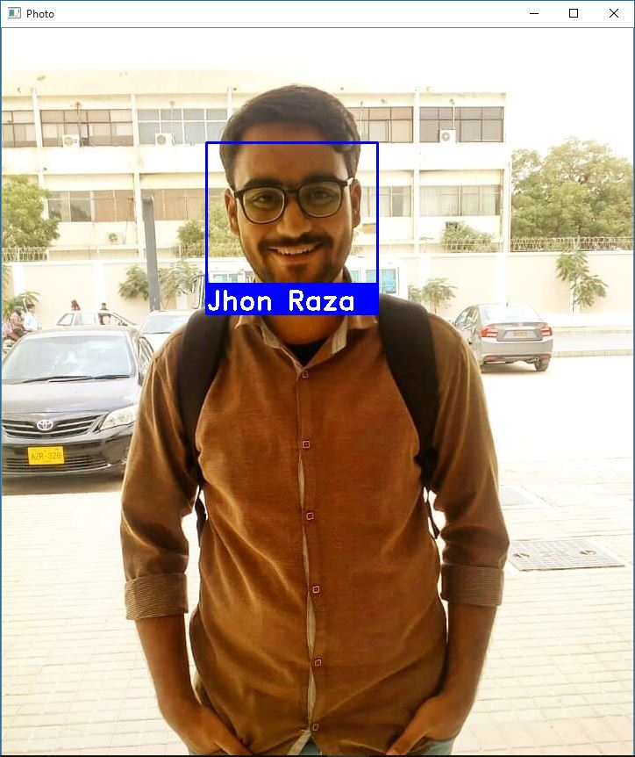
EXAMPLE OUTPUT FOR PICTURE RECOGNITION

Slide 10
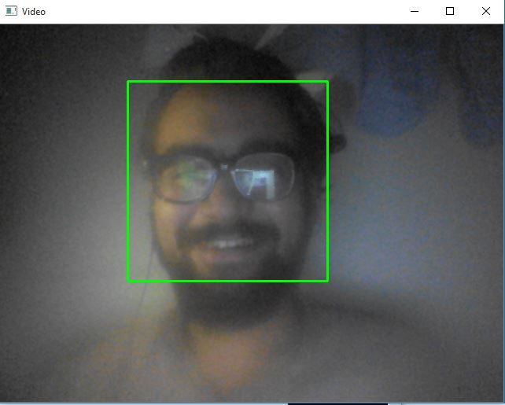
FACE DETECTION (VIDEO) EXAMPLE OUTPUT

Slide 11

Face recognition IN KERAS USING Face net BY S.M.ALI

Slide 12
ABOUT FACE RECOGNITION
Face Recognition usually involves three stages which includes Face Detection, Extraction and Classification.
FaceNet is primarily used for the face extraction.

Slide 13
Salient FEATURES
FACENET MODEL
KERAS
MTCNN
LVSM(Linear Vector Support Machine) using sklearn

Slide 14
What is facenet ?
Given a picture of a face, FaceNet will extract high-quality features from the face, called face embeddings, that can then be used to train a face identification system.
A face embedding is a vector that represents the features extracted from the face.

Slide 15
KERAS
KERAS is an Open Source Neural Network library written in Python that runs on top of Theano or TensorFlow.

Slide 16
MTCNN
In Multi-Task Cascaded Convolutional Neural Network (MTCNN), face detection and face alignment are done jointly, in a multi-task training fashion. This allows the model to better detect faces that are initially not aligned.
This model has three convolutional networks (P-Net, R-Net, and O-Net) and is able to outperform many face-detection benchmarks while retaining real-time performance.
source: towardsdatascience

Slide 17
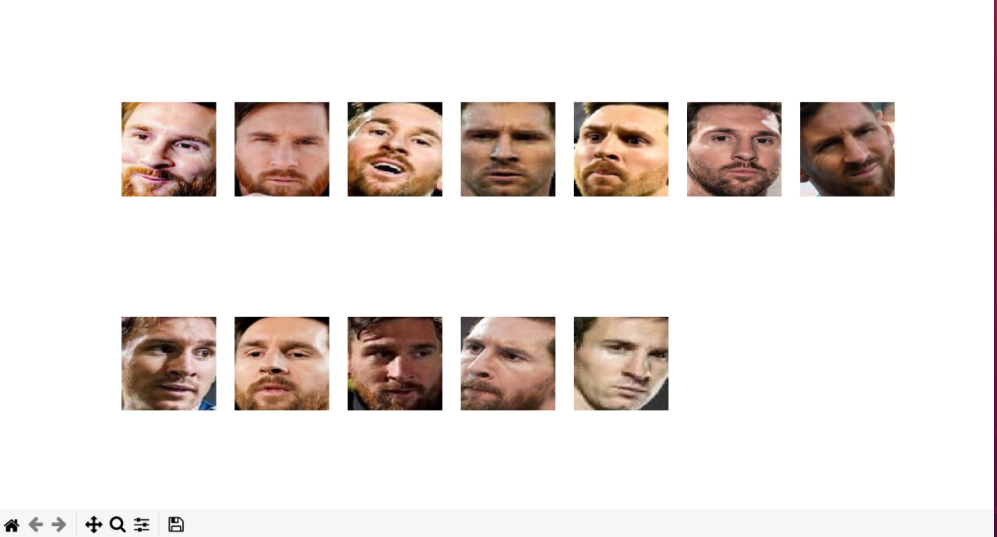
EXAMPLE FACE EXTRACTION IN MTCNN MODEL USING FACENET MODEL

Slide 18
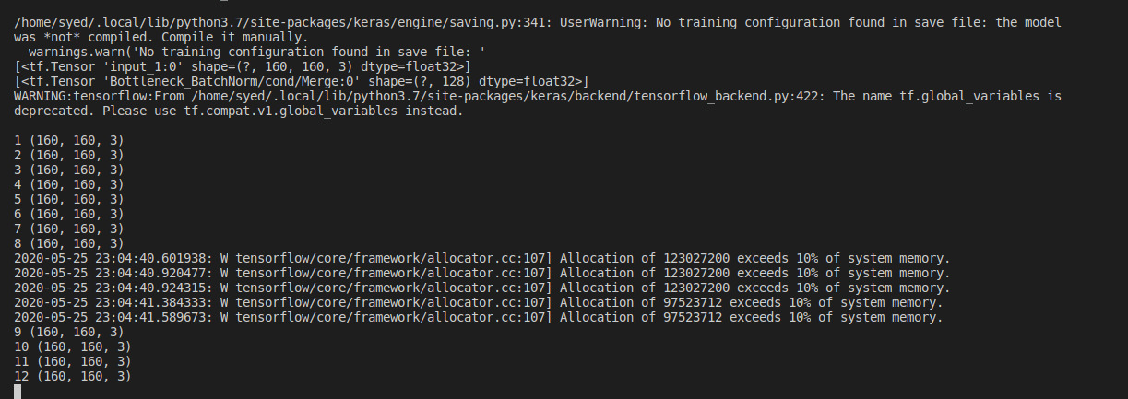

Slide 19
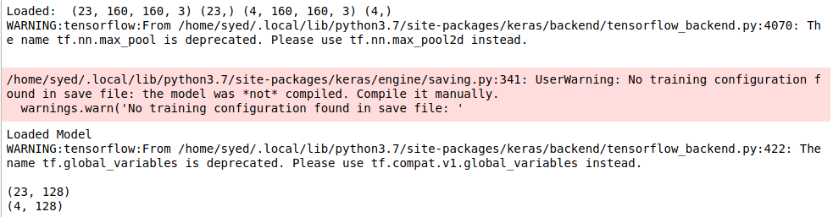
Loading both the training and validation datasets

Slide 20
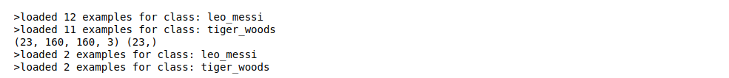
Creating face embeddings for both training and validation datasets

Slide 21
SIZE of the DATAset and training and test accuracies

Slide 22
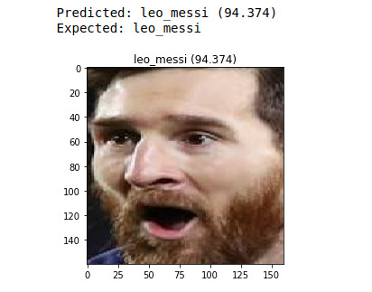
Accurately recognizing image with a greater probability

Slide 23
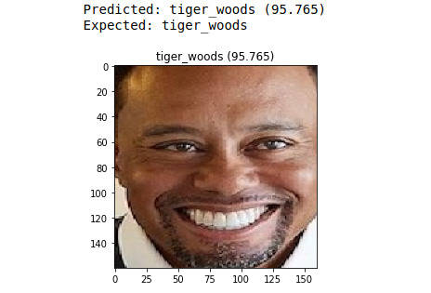
ACCURATELY RECOGNIZING IMAGE WITH A GREATER PROBABILITY

Slide 24
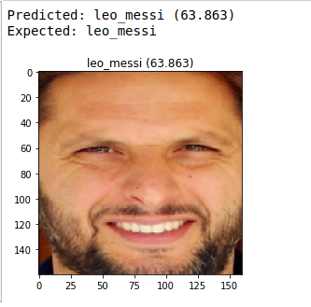
Passing A FALSE IMAGE RESULTS IN WRONG PREDICTION WITH A LESSER PROBABILITY

Slide 25
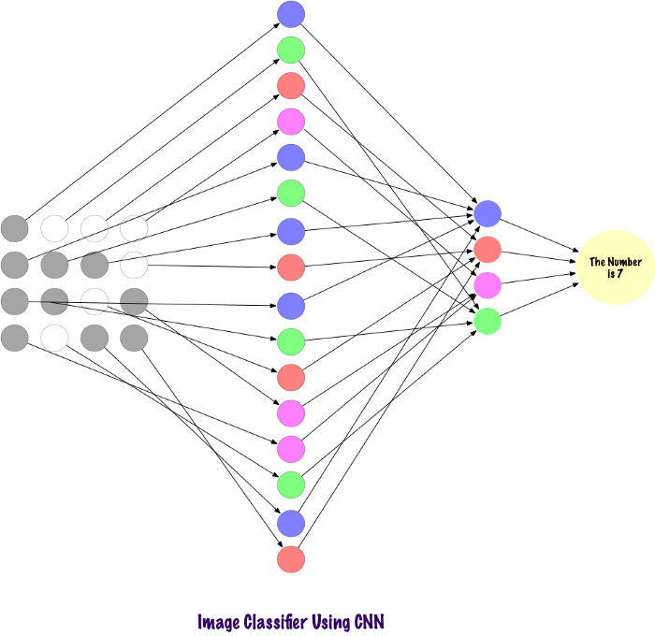
FACIAL RECOGNITION THROUGH CONVOLUTIONAL NEURAL NETWORKS
BY HAMZA RAZA
Hamza Raza

Slide 26
What are Convolutional Neural Networks(CNN)
In deep learning, a convolutional neural network is a class of deep neural networks, most commonly applied to analyzing visual imagery.
A ConvNet is able to successfully capture the Spatial and Temporal dependencies in an image through the application of relevant filters. The architecture performs a better fitting to the image dataset due to the reduction in the number of parameters involved and reusability of weights. In other words, the network can be trained to understand the sophistication of the image better.
So if we have a RGB image so You can imagine how computationally intensive things would get once the images reach dimensions, say 8K (7680×4320). The role of the ConvNet is to reduce the images into a form which is easier to process, without losing features which are critical for getting a good prediction.

Slide 27

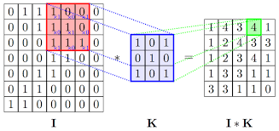
How does ConvNet Works
The Convolution process Is shown on upper left part of screen in which a 9 x 9 x 1 Image metric is multiplied by a 3 x 3 metric shown below which is also known as kernel so this way of convolving our 9 x 9 x 1 image we get a resultant 3 x 3 x 1 metric which we can use later on in neural network hence we have reduced the size of image but we can see that there was only one channel of image like it wasn’t a RGB with 3 channels so if it was RGB then all the 3 channels will also be convolved into a resultant 3 x 3 x 1 metric but the kernel will be then of 3 x 3 x 3 dimensions.
So there are two important parts of convolution process the number of strides which is how many squares we will move to calculate the next output of convolved image and number of filters or kernels which gives us channels in our convolved output

Slide 28
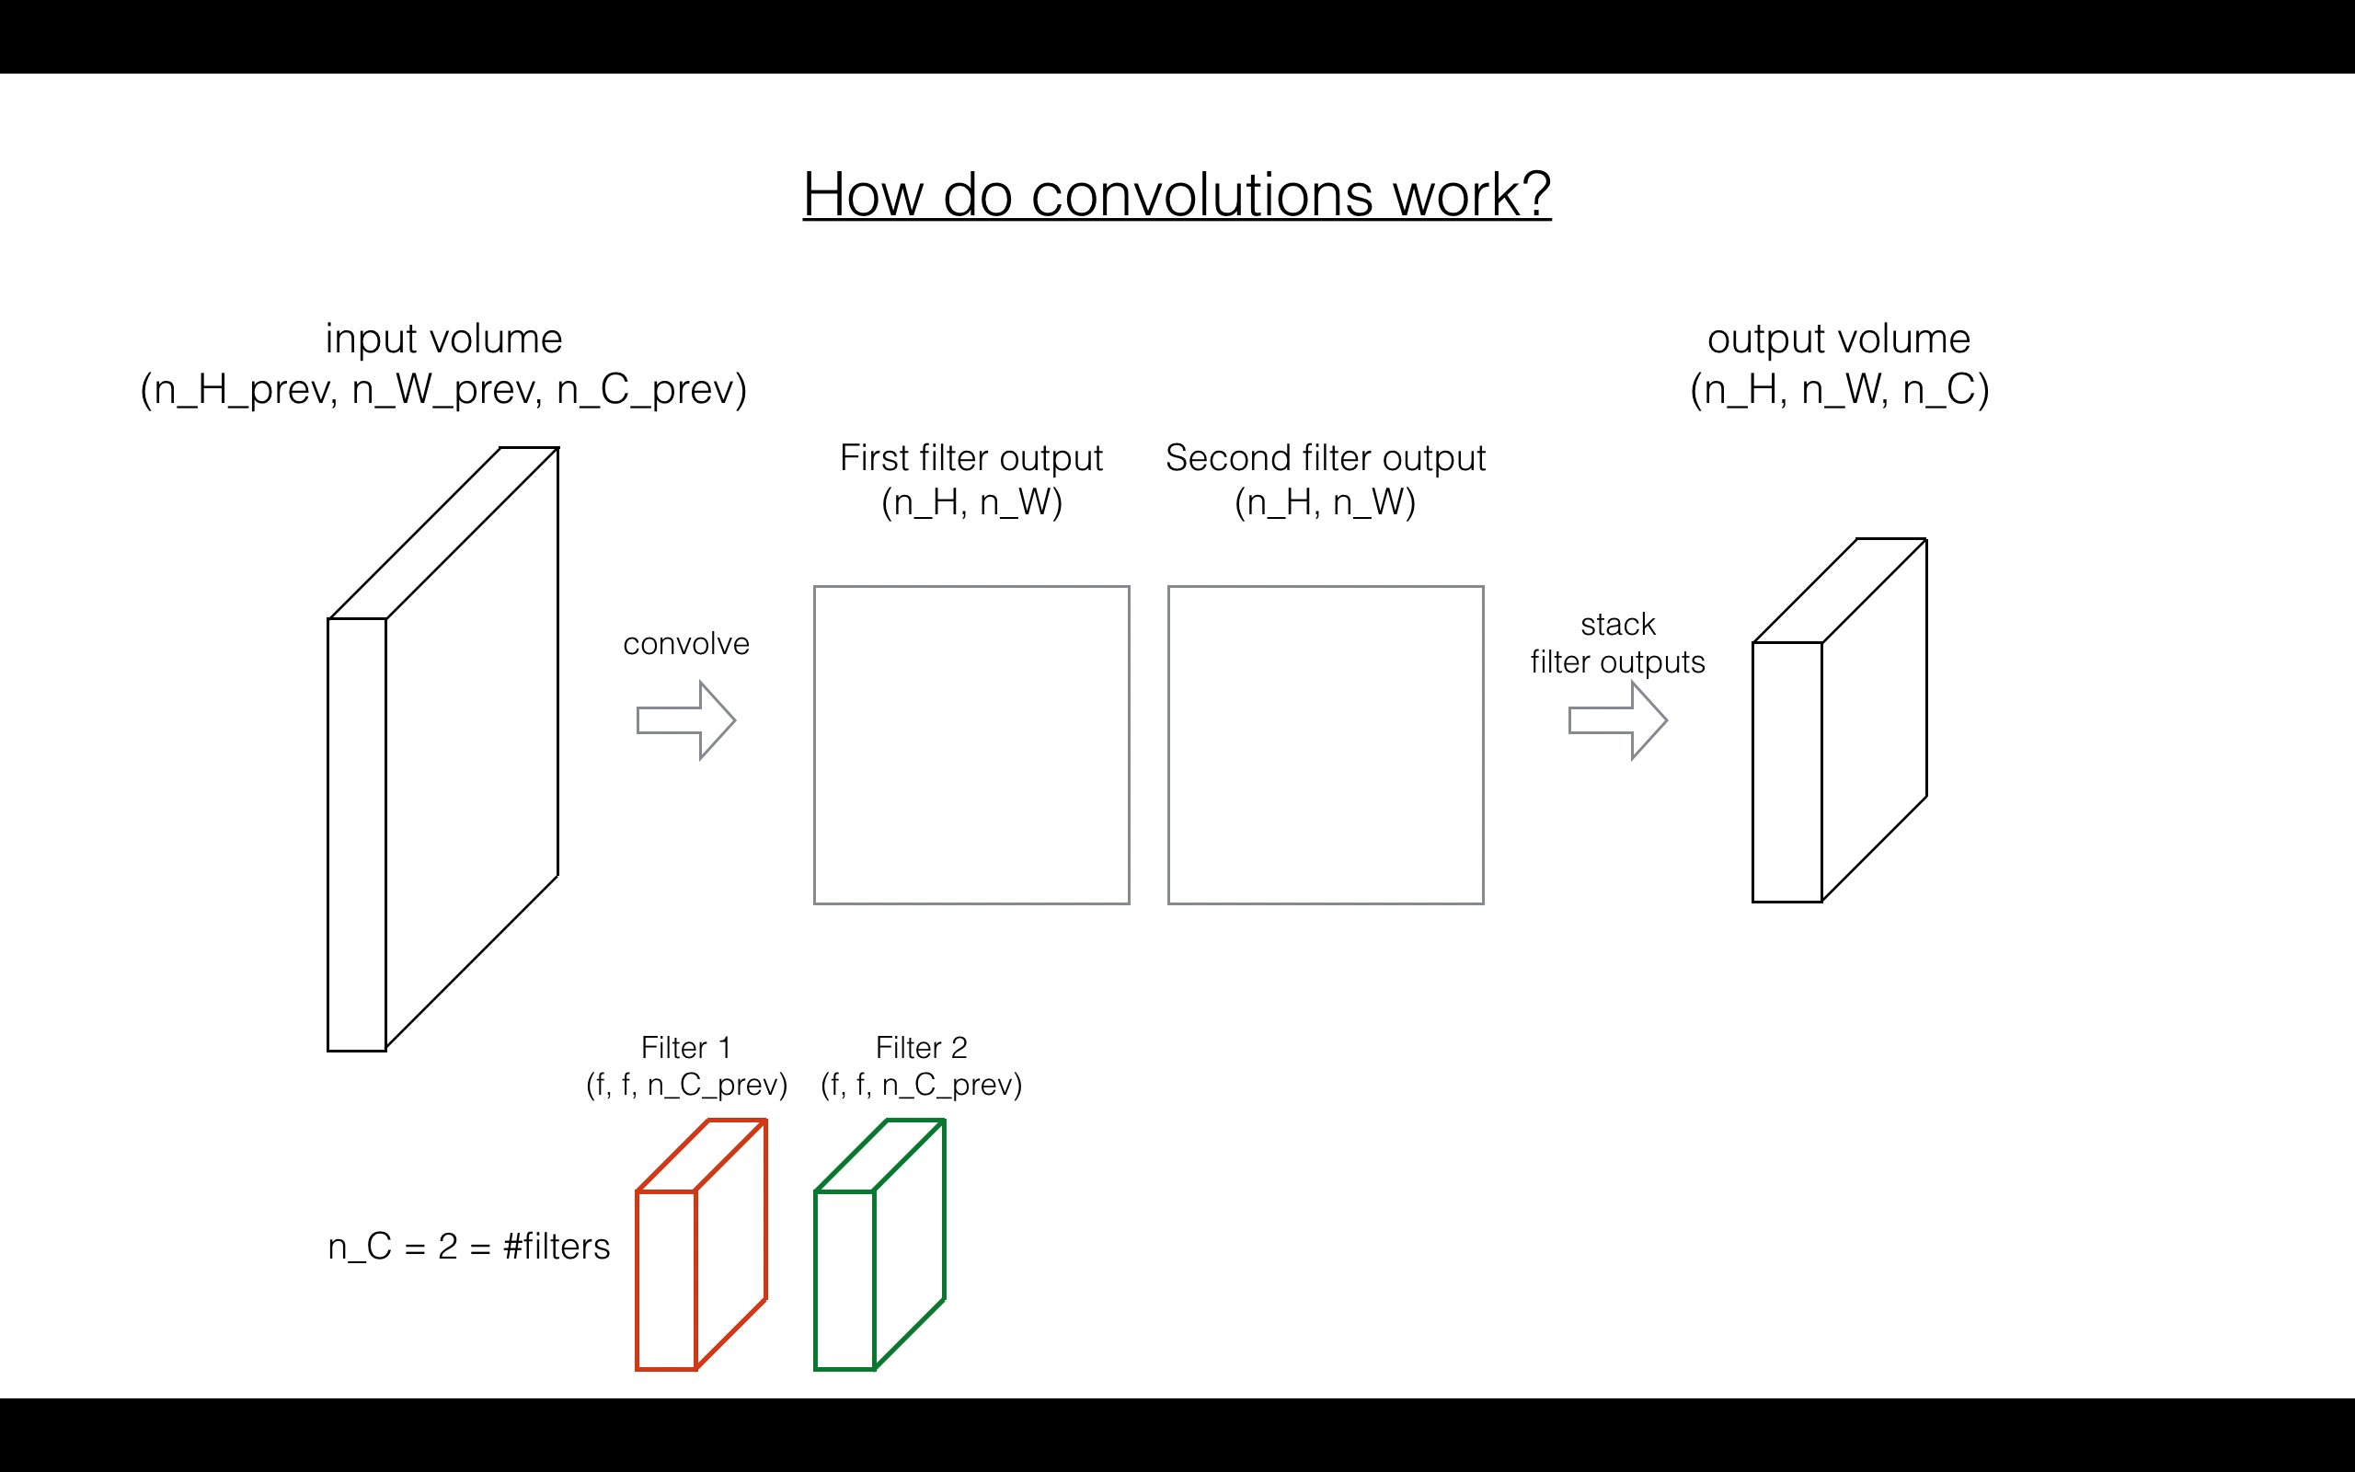


Slide 29
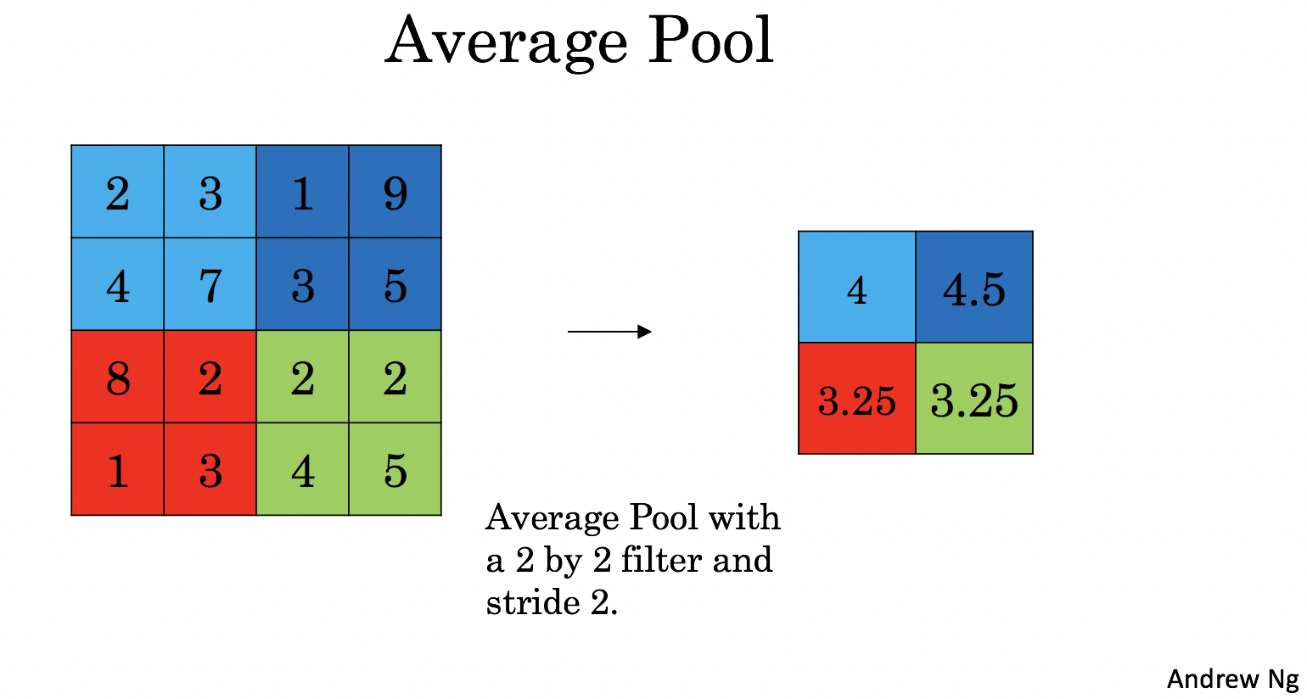
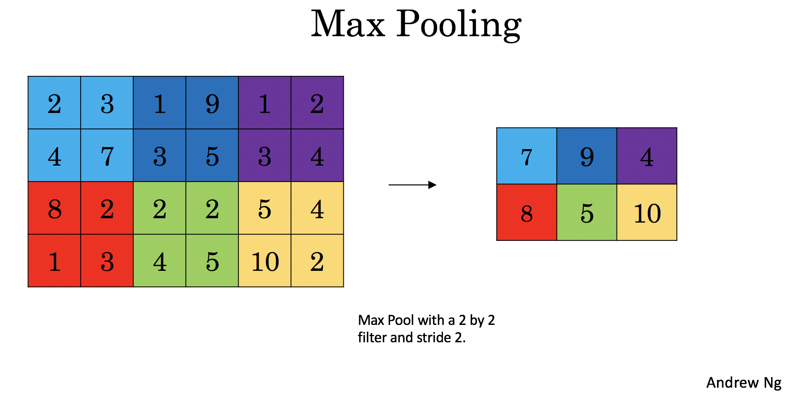
MAX POOLING AND AVERAGE POOLING

Slide 30
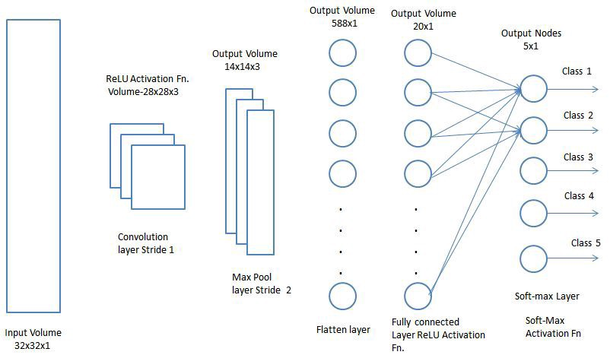
Fully Connected Layer

Slide 31
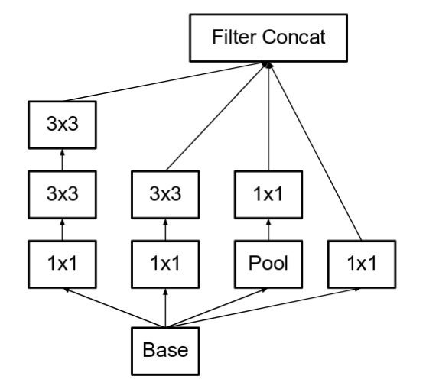
Inception Block
Inception block: is before sending our image to fully connected layer we use different forms of convolutions on our image both in serial and parallel ways and then merge all our results.

Slide 32
My Code
The pretrained weights and the model that I have used is by Victor Sy Wang's implementation and was loaded using his code: https://github.com/iwantooxxoox/Keras-OpenFace and also from the course of Convolutional Models from Deeplearning.ai.
The Libraries used in this code are
Tensor Flow
Keras
OpenCv
sklearn
Mtcnn
Playsound
Gtts

Slide 33
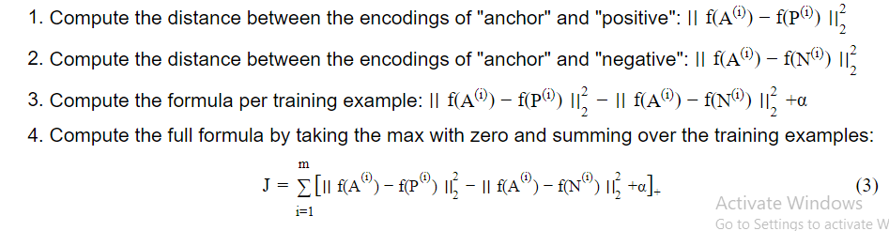
So Basically I have used a Convolutional Model which have 7 inception blocks
Inception Block 1a containing a 3 x 3, 5x5 and 1x1 convolution layers and a Maxpool layer
Inception Block 1b containing a 3 x 3, 5x5 and 1x1 convolution layers and a Maxpool layer
Inception Block 1c containing a 3 x 3, 5x5 convolution layers and a Maxpool layer
Inception Block 2a containing a 3 x 3, 5x5 and 1x1 convolution layers and a Maxpool layer
Inception Block 2b containing a 3 x 3, 5x5 convolution layers and a Maxpool layer
Inception Block 3a containing a 3 x 3, 1x1 convolution layers and a Maxpool layer
Inception Block 3b containing a 3 x 3, 1x1 convolution layers and a Maxpool layer
These all inception blocks are in 5 convolutional layers and in the last applied Average Pooling to the output before Flattening it.
For Facial recognition I have use triplet loss as my algorithm for identifying the images which is a one shot learning in which we only provide a single image of a person and an anchor(same image) and a negative image.

Slide 34
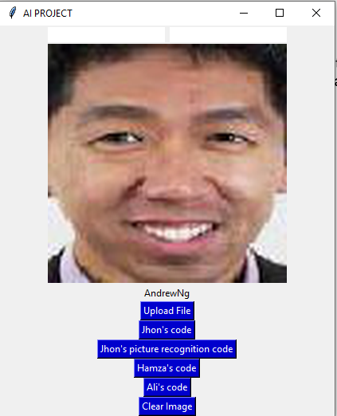
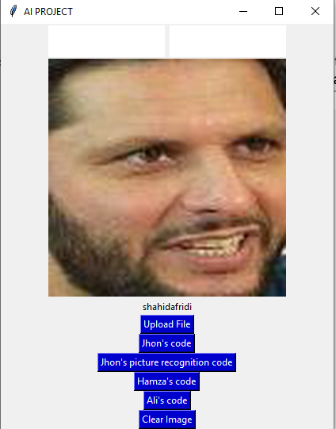
I have used Total of 20 Images to test my model on means these 20 images will be compared with the inputted Images which are about 80 so my model gave an accuracy of 9/80

